Slide 1

Inheritance
Inheritance looks kind of interesting, but when would we really use it?
Well, it turns out, in Java, we've been using Inheritance all along.
COMPLETE JAVA MASTERCLASS
What is java.lang.Object?

Slide 2
java.lang.Object
This is because every class you create in Java, intrinsically extends a special Java class.
This class is named Object, and it's in the java.lang package.
Ok, that's confusing, a class called Object?
Let's see what Java has to say about this class.
We'll use the link to Java's Application Programming Interface (API) for this class, which you can find in the resources section of this video.
COMPLETE JAVA MASTERCLASS
What is java.lang.Object?

Slide 3
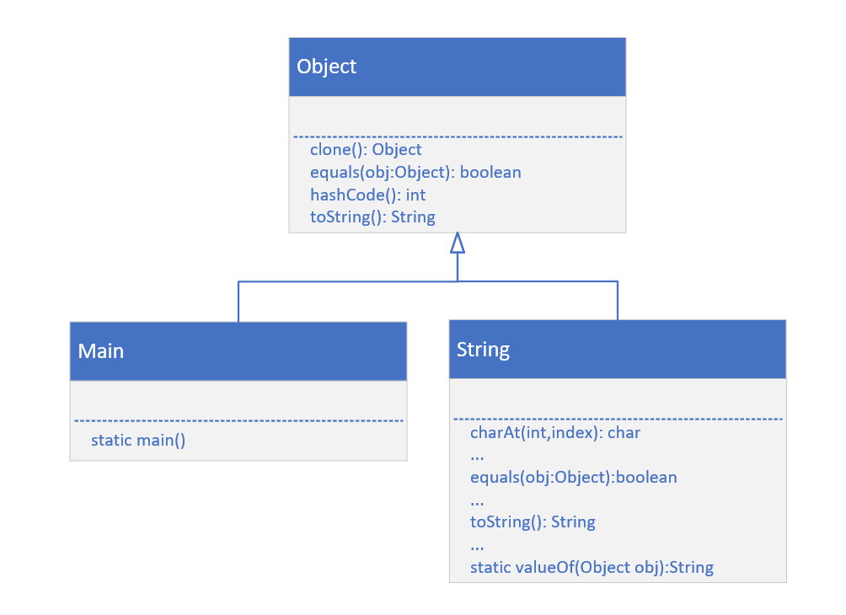
Every Class inherits from Object
This slide shows that our Main class inherits from, or is a subclass of Object, as also is String.
The String class has over 60 methods!
The String class overrides several methods on Object, two of which are equals(), and toString().
COMPLETE JAVA MASTERCLASS
What is java.lang.Object?

Slide 4
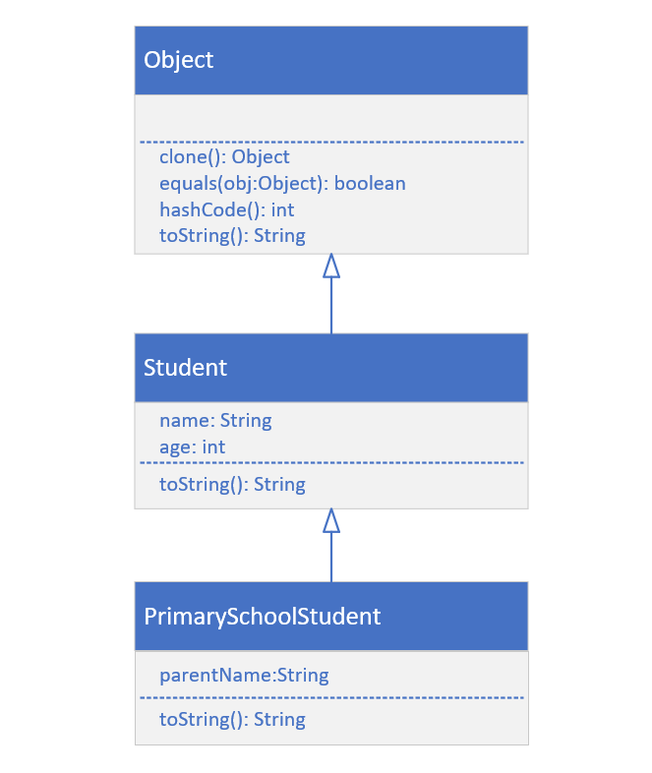
Class Diagram for Student and PrimarySchoolStudent
We've already built Student, which inherits from Object implicitly.
Next, we'll build PrimarySchoolStudent, which will inherit from Student.
COMPLETE JAVA MASTERCLASS
What is java.lang.Object?

